Slide 1
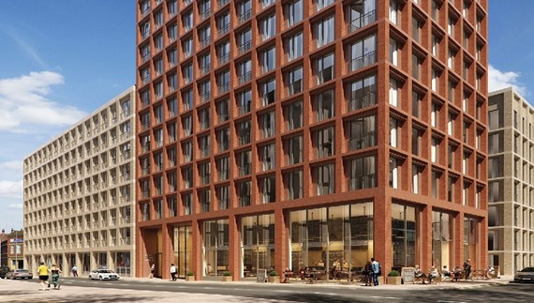

KENT STREET BATHS
CUSTOMER SERVICE & AFTERCARE
INTRODUCTION

Slide 2


WINVIC CUSTOMER SERVICE TEAM
Winvic Customer Service Team has over 42 years of experience in front line customer facing service within the construction, maintenance and engineering industry.
Our aim is to drive loyalty along the customer journey, analysing defects, trends and capturing the voice of our customers enabling us to feedback into the business for continuous improvement.
We will work with you to ensure defects are tracked and closed out in a timely manner, ensuring you and your team receive regular updates.
Laura is responsible for overseeing projects for Multi Room and works in partnership with Healthy Estates Facilities Management and contractors.
Laura remains with her projects for the duration of the defect liability period until Make Good Defect Certificate is achieved.
Becky manages and oversees the whole defect process and customer journey for Multi Room.
Becky works with our partner Healthy Estates Facilities Management (HEFM) and contractors to review our service delivery ensuring defect SLAs are met.
Becky Morgan
Laura Harper
Senior Customer Service Manager
Customer Service Manager

Slide 3


Sectional completion for Block A, C & D is due May 2024, with handover for Block B being November 2024 (S278 June 2024) the building will be checked by Winvic teams, involving our clients' respective teams, this is called ‘snagging’
The Project Team from Winvic are responsible for closing snags for sign off and will remain on site to ensure they are resolved where possible.
Winvic Customer Services will support The Building Management Team to understand the building and offer guidance to maintain the assets.
LIFE AFTER PRACTICAL COMPLETION
After Practical Completion, defect notifications will be dealt with by Winvic Customer Service in partnership with HEFM.
Our aim is to work closely with you to resolve reported defects within the agreed timescales.
The Customer Service Manager will arrange to meet with The Building Management Team at regular intervals to ensure the defects are closed out to everyone’s satisfaction.

Slide 4

SNAG VS DEFECT
SNAG | DEFECT
a minor problem or issue that is usually easy to fix. It is something that is not critical to the overall functioning of a product or system. | is an installation that is not performing, as per the specification, design or install after Practical Completion.
is an issue picked up by Winvic Site Team, Clients Representative or Client and compiled from pre-handover inspections. This is a long process that starts months prior to handover and ongoing up to Practical Completion. | is a problem that affects the performance or quality of a product or system. It can cause the product to malfunction or not meet its intended purpose.
is documented onto a list of locations and issued to the Winvic Site Team to formally close out within an agreed timeframe, set by the Clients Representative.
is completed and back checked by the Clients Representative and signed off accordingly.

Slide 5
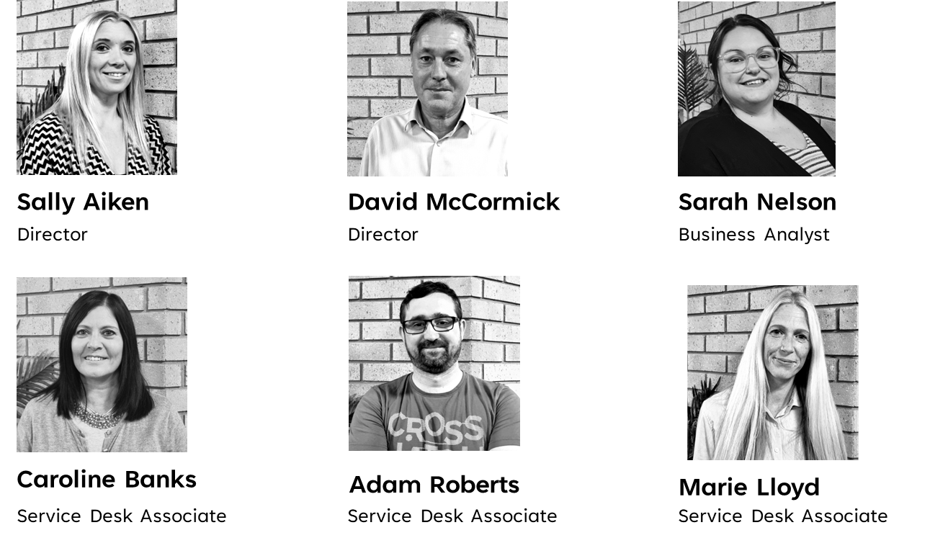
HEFM CUSTOMER SERVICE TEAM

Slide 6

FIXFLO DEFECT PORTAL
Winvic have partnered with HEFM to manage the
day to day defect process.
HEFM facilitate the FIXFLO Portal and monitor progress with
our sub-contractors to ensure you receive regular updates via the system, reducing email communication.
We will require a central inbox to set up your FIXFLO account. You will receive a log in code with the link to access the portal. You will be prompted to change your password when you first log in.
FIXFLO will provide you with live updates, including scheduled appointments to enable The Building Management Team to manage access with residents and their expectation.

Slide 7
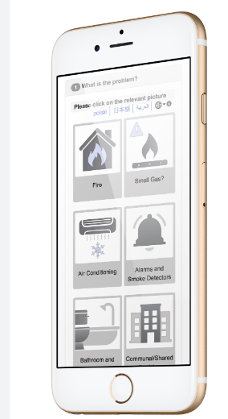
DEFECT REPORTS
To log a defect, it is essential Winvic/HEFM is provided with as much detail as possible, including the following:-
1) Location (Precise Location)
2) Investigation (Trouble shooting / Fault Finding)
3) Maintenance Checks (Last Maintenance / Servicing Information)
4) Additional Information (Suitable Access Days/Times)
5) Priority
We recommend that The Building Maintenance Team utilizes the Dashboard Tablet to report defects. It will prove invaluable, enabling real time photos/videos to be loaded, access to O&Ms to reference drawings and quick access to FixFlo dashboard.
HEFM will not accept defect notifications without evidence of maintenance, service regime and image/video of the defect.

Slide 8

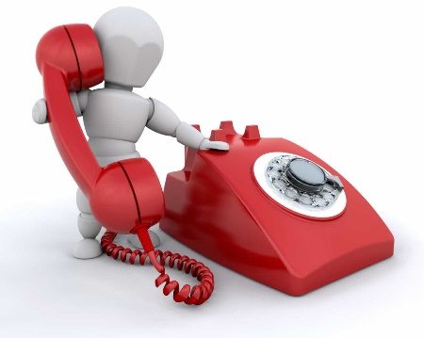
24-7 EMERGENCY REPORTING
In the event of an emergency defect, we recommend that as a duty
of care the Building Management Team ensure that areas are made
safe to prevent risk and damage.
It is essential that the trouble shooting guides are followed and maintenance confirmed in the call out report. Please state the obvious to prevent any confusion. Ensure trouble shooting guides are followed prior to phoning as call out charges will be incurred if it is found to be a non-defect/due to lack of maintenance
ALWAYS CALL FIRST to ensure HEFM can arrange a quick response.
There after please log the details and photos on FIXFLO
Project name:
1. The Project Team
ELECTRICAL & MECHANICAL DEFECTS
HEALTHY ESTATES FACILITIES MANAGEMENT
0333 996 0888

Slide 9
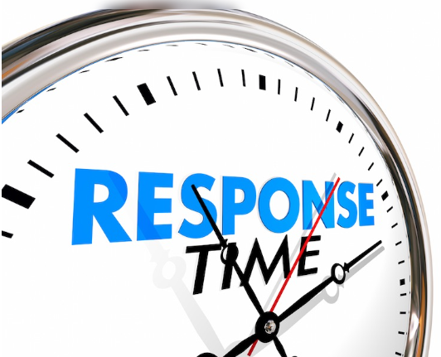
CONTRACTUAL DEFECT RESPONSE TIMES
DEFECT CATEGORY | RESPONSE TIME
CAT 1 - Emergency Defect | Within 12 Hours
CAT 2 – Urgent Defect | Within 48 Hours
CAT 3 – Routine Defect | Within 14 Working Days
CAT 4 – Follow Up | Within 28 Working Days
CAT 5 – End Of Defects | End Of Defect Liability Period

Slide 10
DEFECT CATEGORY EXAMPLES
EMERGENCY DEFECT
(As a Duty of Care and prevention we recommend our customers make safe immediately) Dangerous Electrics / consumer unit failure Fire/Smoke alarm / detector failure Burst pipe: isolated by stop valve in the first instance. Defect that may cause injury Total Heating failure (seasonal) Localised blocked Drains / WC’s / shower within the first month Main drain blockage - within 2 months from Practical Completion Security at low level: external door/window make safe only Lift failure: call lift company direct and log on the FIXFLO with full details Lift entrapment: There is an emergency call button in the lift care or call main number immediately with the Lift data number.
SERIOUS DEFECT
No hot water Total heating failure (seasonal) Door Entry failure Unstable paving/steps - make safe only Electrical: lighting failure, this does not include lamps Investigate roof leak Water leak / weep - minor - containable Water penetration doors / windows / walls / ceilings – investigation

Slide 11
DEFECT CATEGORY EXAMPLES
ROUTINE DEFECT
Electrical: 1 heater failure Electrical: 1-2 power socket failures Electrical: 1 light failure Mechanical: shower over bath failure Power to Washing machine Flooring lifting, potential trip hazard - follow up from making safe. Main entrance: intermittent fault but secure Follow up remedial work following a defect External lights staying on. Window will not open – part required External pavers pooling – no trip hazards
DEFERED TO END OF DEFECTS
Landscaping Issues Mastic Failures – Small Areas that do not result in leaks

Slide 12


LIFT BREAKDOWNS
24-Hour Contact Centre for Emergencies and Breakdowns
Report all faults direct to the KONE National Customer Contact Number
0800 652 0692
Fire Fighter lift
Standard lift
Standard lift

Slide 13
USEFUL INFORMATION - LIFTS
Report faults direct to the Kone National Number 0800 652 0692
Please ensure the defect and log number is raised on FIXFLO Portal to enable Customer Service to monitor progress.
it is essential to complete a New Owner Registration Form to ensure the 12-month contract is activated for your warranty cover
Lift service agreement for 12 months from the commissioning certificate and will include parts and labour.
4 Service visits during working hours
The lifts have a World SIM card installed that uses the network with the strongest signal. Please note the diallers cannot be tested by the customer or consultants, they only dial out when the lift is in fault
Please check the following before reporting a lift defect to prevent any costly recharges:-
Lift reference numbers are displayed on the data plate inside the lift
Red & white light – no entry means something has blocked the doors and it is essential to will need to check all doors on each floor
If doors wedged, it will cause lift to fail
Check runners and ensure vacuumed regularly

Slide 14


Training - Winvic Project Team will organise training for your building’s systems.
Attendance - Highly recommend the Building Managers & Maintenance Team attend
Recording - Training will be recorded and loaded onto Dashboard.
It is essential that maintenance is completed regularly as a lack of attention may cause damage to your building and its systems which will not be covered by Manufacturers Warranty or Winvic Construction Ltd. This includes minor adjustments and fair wear and tear.
Full technical details of the buildings operation is contained within the Building Manuals and should always be referred to for specific information.
PREVENTIVE MAINTENANCE

Slide 15
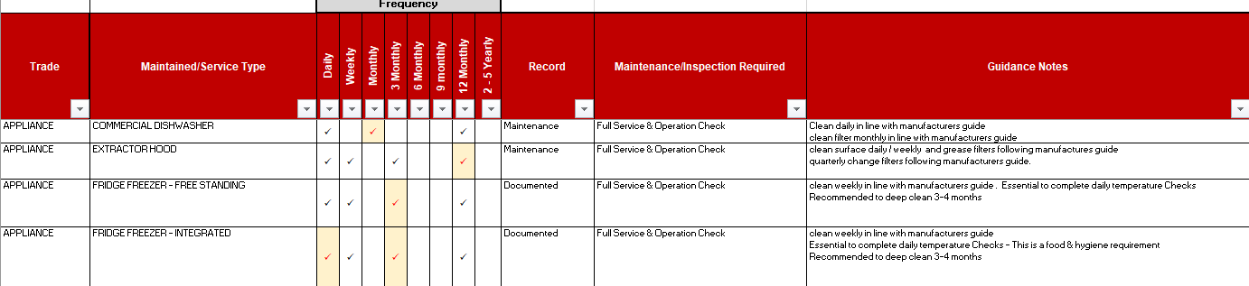
It is the responsibility of the occupier to co-ordinate and evaluate any recommendations made with the manuals to establish a planned maintenance programme and statutory requirements.
The Aftercare Plan provided is not intend to conflict with or preclude any statutory or standard maintenance programme, practices or procedures established. It is essential that Risk Assessments are undertaken by the occupier for all aspects of cleaning and maintenance in accordance with the HSE statutory requirements.
Winvic Customer Service Manager will provide some guidance and useful information for key areas.
SERVICE AND MAINTENANCE

Slide 16
FIRE DOOR MAINTENANCE
We advise our clients and customers of Government Regulation changes during review meetings and on email. The most recent change included Fire Door Maintenance implemented on 23 January 2023.
Please ensure that the Appointed/Responsible Persons familiarise themselves with the changes to the Fire Safety (England) Regulations and implement required documentation.
We recommend complying with 6. Routine checking of fire doors :
An Appointed /Responsible Persons is Fire Door Trained and certified.
Develop a fire door register.
Number or tag all fire doors.
Mark up As Built Drawings with registered fire door numbers.
There are several regulators, ASDMA (Architectural and Specialist Door Manufacturer Association), that provide approved fire door training.
The Fire Safety (England) Regulations 2022: Fire Door Guidance
https://www.gov.uk/government/publications/fire-safety-england-regulations-2022-fire-door-guidance/fire-safety-england-regulations-2022-fire-door-guidance
.

Slide 17
MAINTAINING EMPTY APARTMENTS
Whilst minimal defects occur in unoccupied apartments/rooms it is crucial that they are included routine maintenance checks.
Unoccupied apartments can still develop minor defects and leaks and are susceptible to extreme temperature and climate changes.
Follow the O&M guide and Service/Maintenance Guide for specifics, and complete documented routine checks to include, but not exhaustive:
Check for leaks, bath, shower, toilet, WHB, washing machine, dishwasher.
Sprinkler heads.
Smoke and heat detectors
Ventilation (MVHR is running and boost working).
Heater/s are on minimum setting during winter months to reduce movement i.e. internal doors.
Window/door openings checked, remove dust and debris and lubricate moving components.
Ensure toilets, taps are operational (this is normally included in Legionella checks).
Visual checks of skirtings, flooring, ceilings for signs of ingress.
Windows are closed when raining and storms.
Periodically run appliances – check for minor leaks.

Slide 18
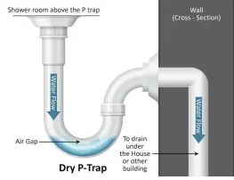
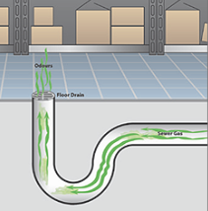
DRAINAGE SMELLS
Can you smell drains in the bathroom or commercial kitchen?
Sometimes drainage smells can come from the bathroom / ensuite or commercial kitchen floor, everyone naturally assumes it is a blocked drain. It will more than likely be related to a trap to the waste drying out.
The U-shaped pipe is designed to hold water to prevent sewer gases from coming up. It happens in locations that are not frequently used the waste traps dry out. The water inside the pipe often evaporates and allows the gases to pass through into the room, causing the unpleasant smell.
The drainage system works by there being a foul connection to the main sewer system. The main sewer system rises through the floors where it terminates above at roof level with an open vent. At each floor there are branches which feed the shower / bath outlets, wash hand basins, toilets, and sinks.
The wastewater then flows down the pipework, to below ground where it is taken away. The open vent at roof level allows for air to enter the system to prevent there being a vacuum when the water runs down the pipe. All waste outlets will have a trap of a certain type which holds a level water line to prevent the odours from the drains entering the building
Fixing this issue is simple; pour water down the tub or sink drain to refill the pipe.

Slide 19
OPERATION AND MAINTENANCE MANUALS
Once the building has achieved Practical Completion you will receive a tablet with all your operating manuals pre-loaded. The manuals are vast, and the Customer Service Manager will guide you to ensure you use your tablet effectively.
We can offer your Building User Guide to be loaded onto a QR code of which we recommend locating in Utility cupboard. This will support The Building Management Team, allowing the maintenance team to identify a genuine defect. Winvic have examples of user guides that may prove helpful, this is available on request.
We recommend extracting the trouble shooting guides from M&E sections to support The Building Maintenance Team. It is essential that the tablet is accessible to all users. They are the “owners manual” containing As Built Drawings, mechanical and electrical detail and a catalogue of information for cleaning, maintenance, parts, programming and construction details.

Slide 20
AFTERCARE VISITS AND REVIEW MEETINGS
Over the next 24 months Winvic Customer Service Manager will arrange to meet with you and your team on site / Teams meeting platform or on site to review defect reports.
After Practical Completion Winvic / HEFM will contact The Building Management Team weekly during the settling in period to ensure you have the opportunity to ask questions about the building.
We will then arrange regular visits either monthly or quarterly to suit your needs.
Each quarter the Customer Services Manager will arrange a review meeting for defect progress and review the service we provide.
Prior to the end of the 24 months defects liability period a final inspection will be arranged to check and close out remaining defects. This can prove to be a timely process, so planning ahead will assist all parties.
The Customer Service Manager will discuss Final Defects inspection 3 months prior to the end of defect liability period.

Slide 21
HELPFUL HINTS & TIPS
Trouble Shooting – The O&M dashboard contains trouble shooting guides. Always check this first and watch relevant recorded training before reporting a defect. This will prevent unnecessary recharges of which can prove costly.
Basic Maintenance - keep a stock of silicone based lubricant (PTFE based) – this repels water and essential for ironmongery / window and door components for frequent maintenance.
Spare Stock - we recommend a basic supply of spares are stored on site to use in the event of an emergency. If you have not paid in the contract to have spares on site we can request a contractor quote for a basic supply. Please inform us if you wish us to arrange this.
Shrinkage - shrinkage cracks can range from 2mm or above. For the avoidance of doubt - cracking in plastered and/or lined walls, ceilings and floors not exceeding 2mm in width shall not be considered a defect.
Warranty Registration – Ensure warranty registration for appliances has been completed
Legionella (H&S) - A brief guide for duty holders free copy can be downloaded from HSE http://www.hse.gov.uk/legionnaires/faqs.htm

Slide 22

QUESTIONS & ANSWERS

